Slide 1
Micromouse Project – Pinky & the brains
Aaish Bakhtiar – Dawood Shafique – Muhammad Malik Tiwana – Mohammad Abedin – Asif Chowdhury

Slide 2

Group Members​
Aaish Bakhtiar​
Dawood Shafique​
Muhammad Malik Tiwana​
Asif Chowdhury​
Mohammad Abedin​

Slide 3

Abstract​
Requirements​
Design​
Testing Strategy​
Implementation​
Current Global Conditions​

Slide 4
Goal of The Project​
What the micro-mouse problem is? ​
To finish the maze in the shortest time possible.​
To be able to traverse the maze with no crashes.​
Conform to sizes of the maze and make a micromouse with according dimensions.​
The mouse has 10 minutes in which any trip from the start to the target will be eligible for measurement. ​

Slide 5
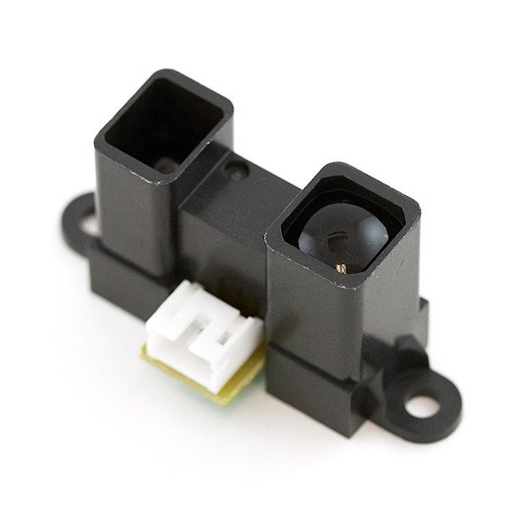
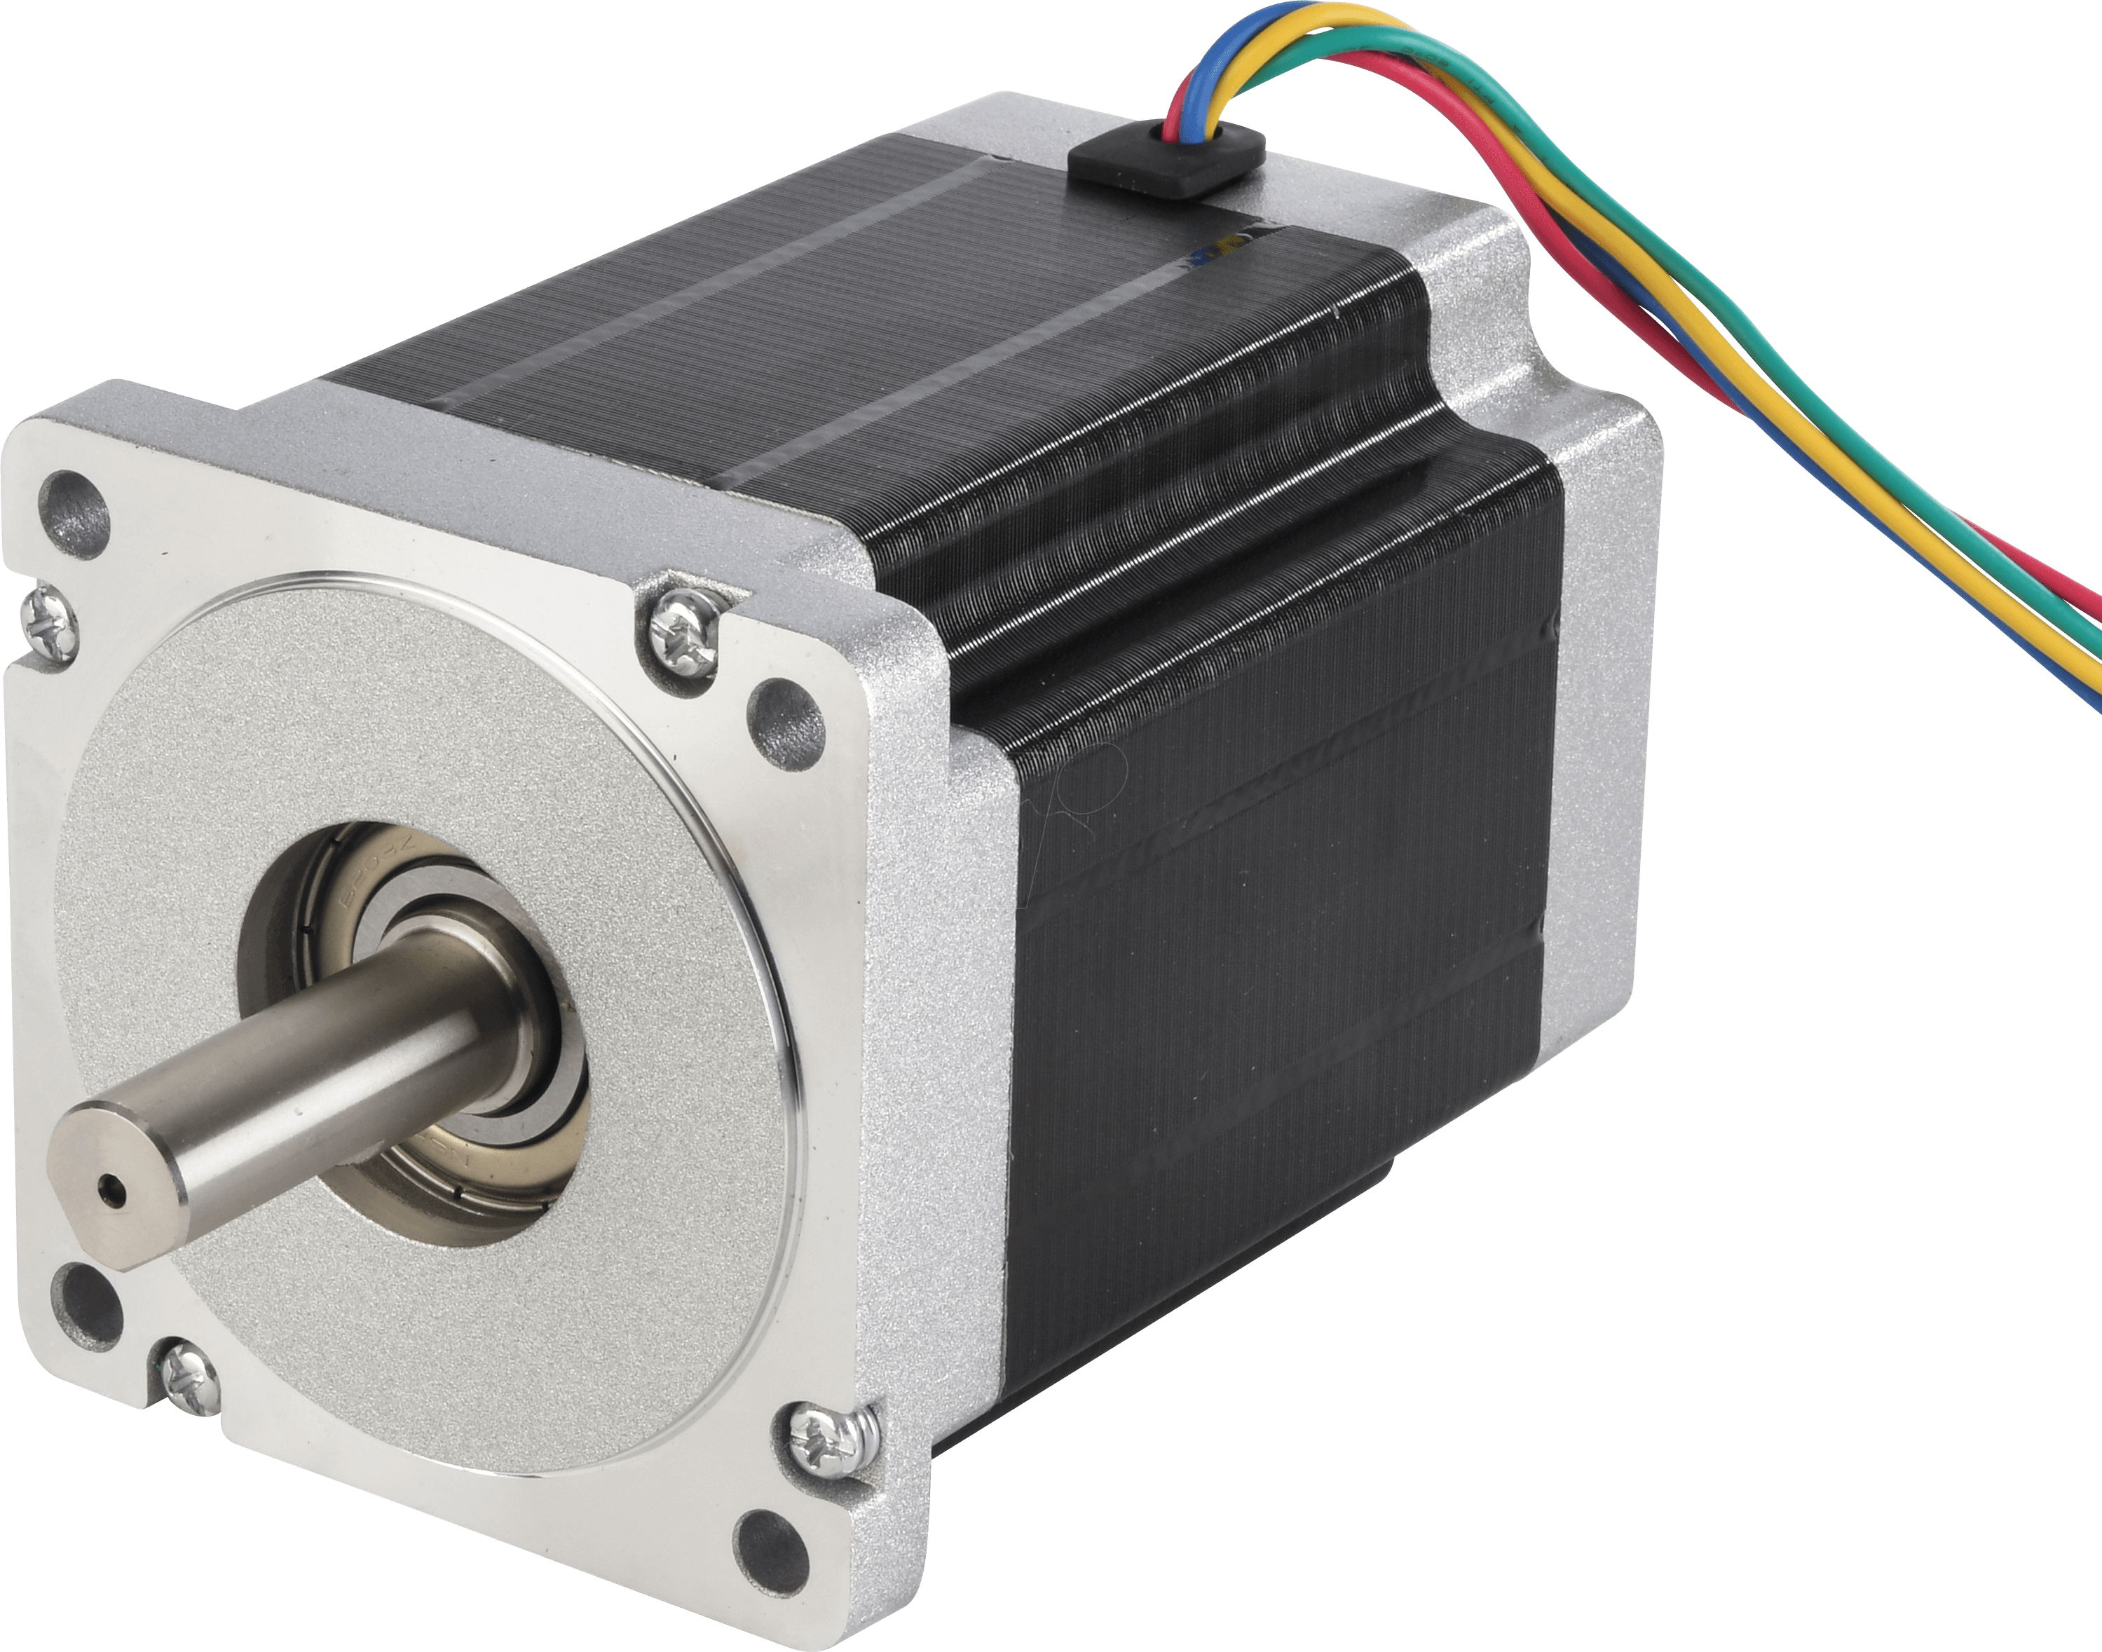
Components​
Main Components of the Micromouse​
Sensors​
Distance & Proximity​
Infrared​
Motors​
Drivetrain​
Speed Control​

Slide 6
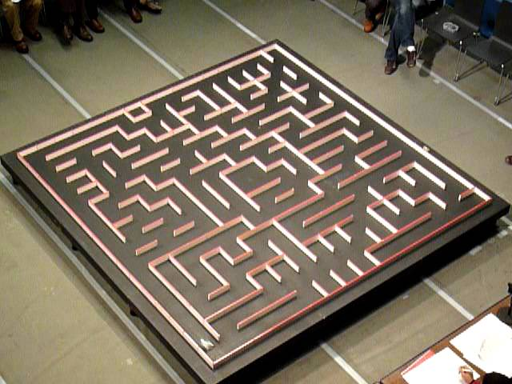
Requirements​
Operating Environment​
Maze Specification​
16 x 16 Cell maze​
256 Cells​
Each Square 18 x 18 cm​
Room Specifications
Light
Noise

Slide 7
Requirements​ ​
Functional Requirements​
Sensor range​
Communication from sensor to microprocessor​
Mechanical Requirements
Maze Navigation​
Running Time

Slide 8
Specification – Motor ​
Choice of Motor​
Unipolar Stepper Motor​
Astrosyn Stepper Motor​
High Torque​
Reduced Noise​
Unipolar or Bipolar Modes​
Smaller Motor for front wheel ​
RS Pro DC Motor​

Slide 9

Specification – Sensor ​
Choice of Sensor​
Distance Infrared Sensor​
Three Sensors​
Easy to configure​
Ambient light​
Modulating Frequency​​

Slide 10
Specification – Power Source ​
Choice of Battery
9v Battery Supply
Duracell​
There are different battery types like zinc and lithium batteries​
Alkaline batteries​

Slide 11
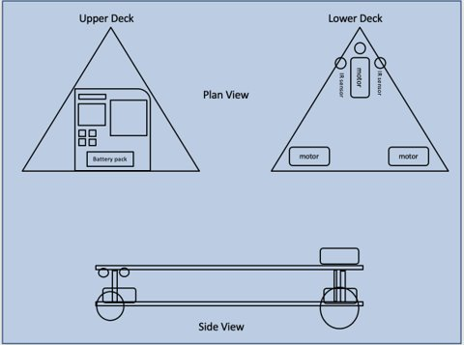
Chassis Design - Dawood ​
As shown in Figure A​
Upper Deck refers to the PCB layout (circuitry)​
Lower Deck refers to the Chassis Layout​
Side view of the micromouse​
Figure A

Slide 12
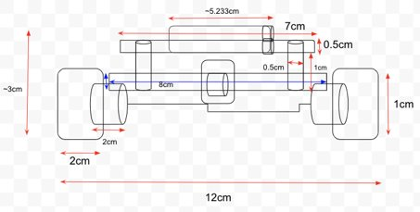
Chassis Dimensions​
Micromouse is of tricycle configuration​
Back-axis (12cm width) bigger than front axis (6cm width)​
Bigger back-axle to front axle allows manoeuvrability ​
Figure B

Slide 13
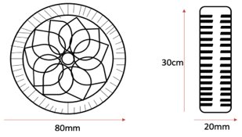
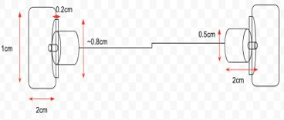
Wheel & Motor Mounting ​
Figure C [13]
Figure D [13.1][13.2]
Wheel’s diameter is 80mm, height is 30mm and width 20mm​
Made of rubber to provide better grip​
Mechanically pushed onto the motor shaft(s)​
Motors and wheels interconnected with the use of mounting brackets​
Brackets placed over motor to allow wheel connection​
Mounting bracket made of aluminium ​

Slide 14
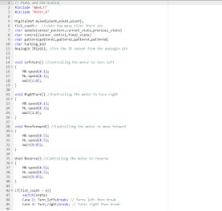
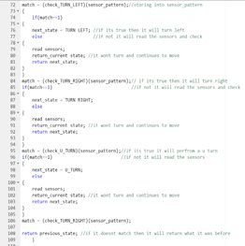
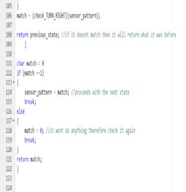
Algorithms and Coding ​
Code for micromouse movements
Forward, Left turn, right turn, U-Turn
Velocity and speed control
If else statements
Decision making
True/False Conditions

Slide 15

Testing​
Battery Consumption​
Run time​
Sensor communication with microprocessor​
Changing to correct states​
Using 4 on board LEDs of MBED board​

Slide 16
Conclusion​
Work together in unison as a group​
Communication Skills​
Trust​
Challenging​
Current Global Conditions​
Learning experience​
Academic Value​
Future Engineering Experience​

Slide 17
Meeting Minutes – Stage 1
Task | Group Member | Deadline | Task Completion Date
- Functional Requirements - Sensors & Motor Types - Design for Tests - Sensor layout & Navigation | Aaish Bakhtiar | 19/02/2021 | 17/02/2021
- Operational Environment - Chassis Design | Dawood Shafique | 19/02/2021 | 15/02/2021
- Mechanics of the Robot | Asif Chowdhury | 19/02/2021 | 18/02/2021
- Power Sources | Muhammad Malik Tiwana | 19/02/2021 | 15/02/2021
- Maze Algorithm | Mohammad Abdein | 19/02/2021 | 16/02/2021
Date :
2nd February 2021 – 19th February 2021
Venue:
Blackboard Collaborate
Attendees:
Aaish Bakhtiar​, Dawood Shafique​, Muhammad Malik Tiwana​, Asif Chowdhury​, Mohammad Abedin​
Minutes Taken By:
Aaish Bakhtiar

Slide 18
Meeting Minutes – Stage 2
Task | Group Member | Deadline | Task Completion Date
Electronic Components Budgets | Aaish Bakhtiar | 17/03/2021 | 15/03/2021
- Mechanical Dimensions & Fittings | Dawood Shafique | 17/03/2021 | 16/03/2021
- Hardware Schematics | Asif Chowdhury | 17/03/2021 | 17/03/2021
- Mechanical Dimensions & Fittings | Muhammad Malik Tiwana | 17/03/2021 | 16/03/2021
- Hardware Schematics | Mohammad Abdein | 17/03/2021 | 17/03/2021
Date :
14th March 2021 – 17th March 2021
Venue:
Blackboard Collaborate
Attendees:
Aaish Bakhtiar​, Dawood Shafique​, Muhammad Malik Tiwana​, Asif Chowdhury​, Mohammad Abedin​
Minutes Taken By:
Aaish Bakhtiar

Slide 19
Meeting Minutes – Final Report
Task | Group Member | Deadline | Task Completion Date
Background Requirements Specification Hardware Design Testing Conclusion | Aaish Bakhtiar | 21/04/2021 | 14/04/2021
Introduction Requirements Hardware Design Conclusion | Dawood Shafique | 21/04/2021 | 13/04/2021
Hardware Design Software Design & Logic Implementation of Hardware | Asif Chowdhury | 21/04/2021 | 20/04/2021
Abstract Requirements Specification Hardware Design | Muhammad Malik Tiwana | 21/04/2021 | 18/04/2021
Hardware Design Implementation of Hardware | Mohammad Abdein | 21/04/2021 | 20/04/2021
Date :
9th April 2021 – 21st April 2021
Venue:
Blackboard Collaborate
Attendees:
Aaish Bakhtiar​, Dawood Shafique​, Muhammad Malik Tiwana​, Asif Chowdhury​, Mohammad Abedin​
Minutes Taken By:
Aaish Bakhtiar

Slide 20
References ​
[13] - “FUT0336 DFROBOT,” TEM - Electric Components, [Online]. Available: https://www.tme.eu/gb/details/df-​
fit0336/accessories-for-robotics-and-​
rc/dfrobot/fit0336/?brutto=1&amp;gclid=Cj0KCQjwrsGCBhD1ARIsALILBYormwsOkrvARBI-​
7ftKmUhnDhmMZ2EcYUJ61k288nnh93FY3jAmhSEaAgS_EALw_wcB. [Accessed 15 March 2021].​
[13.1] - J. Kordik, “How do you mount a step motor?,” Applied Motion Products - A Moon&#39;s Company, [Online].​
Available: https://www.applied-motion.com/news/2015/10/how-do-you-mount-step-motor. [Accessed 16​
March 2021].​
[13.2] - “Mounting Bracket,” RS, [Online]. Available: https://uk.rs-online.com/web/p/enclosure-mounting-​
brackets/1368956/?cm_mmc=UK-PLA-DS3A-_-google-_-CSS_UK_EN_Enclosures_%26_Server_Racks_Whoop-_-​
Enclosure+Mounting+Brackets_Whoop-_-1368956&amp;matchtype=&amp;pla-​
305354315265&amp;gclid=Cj0KCQjw0caCBhCIARIsAGAfuMxLCfQbL. [Accessed 16 March 2021].​

